Slide 1



Slide 3

15
MAY
2017
1
FEB
2017
MIS
1ST PRM

Slide 4
Books
&
LP
TL’s
MONTHLY/WEEKLY REPORTS

Slide 5
BOOKS QC – MONTHLY REPORT

Slide 6
DA
TEAM
EXCEL BASED DATA TOOL

Slide 7
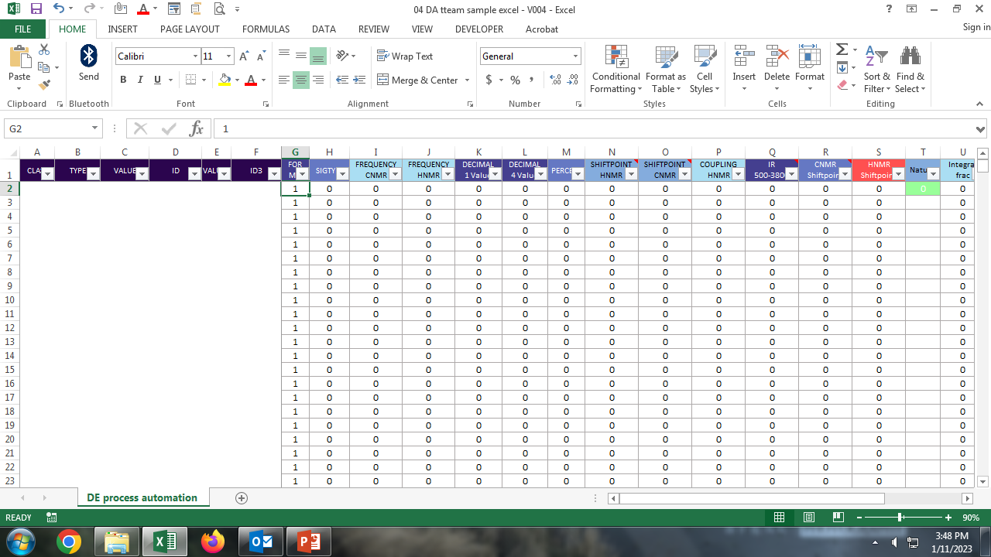

Slide 8
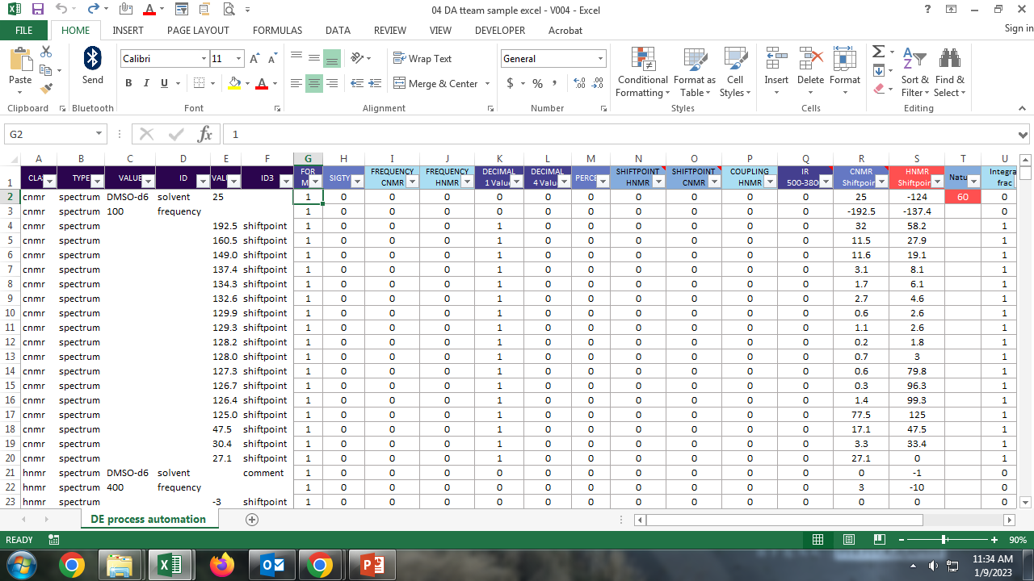

Slide 9
01: if id = HNMR, if value2 is not between -2 to +15 (+) ID3 “SHIFT POINT”
02: if id = CNMR, if value2 is not between -3 to 230 (+) ID3 “SHIFT POINT”
03: if class = HNMR, if id3 = coupling, if value2 >= 30
04: if id = IR, if value2 is not between 500 to 3800
05: if class does not have ‘nature’
06: if class = CNMR, if id3 = shiftpoint, mention value2 column is decreasing, increasing or equal
07: if class = HNMR, if id3 = shiftpoint, mention value2 column is decreasing, increasing or equal
08: if id3 = INTEGRAL if value2 is fraction or zero
09: if class = HRMS if id = found, id = required in sequence then subtract found – required
10: if id = HNMR, if id3 = ‘comment’

Slide 10
Hi Krishna kumar,
The excel based data tool is effective in finding the error which cannot identified manually by data analyst and reviewer. The tool helps to improve the quality of the Data check process in lesser input time. The excel based tool is the stepping stone for expanding the tool based data check process.
Herewith I am sharing the feedback of the all data analyst for EDC excel based tool.
TESTIMONY
VASU
The excel template developed by KK was extremely efficient in picking the errors present in various data types like HRMS, 1H-NMR, 13C-NMR. To be precise, the template lucidly identified the duplicate values in 13C NMR characterization and HRMS [Calcd & Found] close ranges which is hard to identify through naked eyes.
The decimal point errors in 13C [1 digit], 1H [two digits] and HRMS [4 digits] were identified clearly.
Overall, it absolutely helped to generate more number of DA notes in surprisingly less amount of time.
JAYANTHI
- The excel sheet has been well framed for the data check.
- I really appreciate as well admire an excel sheet in order to run the data check.
Though KK is not handling any of the Data Check, he framed the excel sheet with the shared information. It’s really amazing. I wonder his effort in order to frame a working sheet to evaluate the scientific data by means of formulas.
KARTHIKA
I am so happy with this tool now. Really it is very helpful in identifying the error easily, which is unidentified manually.
My suggestion is that either by adding compound name or else number exactly which is available in MS could save our time the most and it will be more beneficial too.
And also I would like to suggest to find any duplicate compound name/number in the MS if possible. Even wrong compound number is given in the title or in the experimental details can be identified if possible.
VANDANA
The excel really works well without any technical glitches, or lags and throws results in a flash irrespective of data size.
The results are prompt and designed as per the need of the Data analyst.
It has eventually improved the quality of notes and highlights both potential and minute errors which can be sometimes overlooked during manual checks.
And Kudos to designer and Developer for making this happen in a short span.
NATARAJAN
It is the first time I am working on this platform it is really wonderful experience to work on this platform. The excel format is really good platform to visualize our chemistry data(which I never thought about it). Yes, initially it took time to learn , it was look like complicated but once we learned it saved lot of time and the mistake we found here it is difficult/impossible to find it manually with naked eye.
My favorite one is hrms identical data , previously it will take me 3- 5 min to find out the mistake which I could do it on just 2 click!
KARUPPUSAMY
Thanks for making EDC excel tool KK Sir.
Really it is wonderful and useful for finding anomalies in the scientific data.
Initially it is difficult for me to use this EDC excel. With the support of ‘Karthikeyan’ I have learned how to use it. Some of the anomalies are hard to find by the manual check process, The excel based support find such error which cannot find manually. Now I am almost familiar with this tool and it gives additional support to improve the quality of data check process. Hence, this is awesome excel tool, and we have been learning this kind of tools more and more this will improve our skills for future perspective. Through this excel tool I am familiar with few excel shortcut keys.
Thanks lots KK Sir.

Slide 11
LANGUAGE
EDITING
EFFICIENCY REPORT EXECUTION

Slide 12
EXECUTING THE EFFICIENCY REPORT ACROSS THE PDMR
Subject : Go Live - December 'LE Production Efficiency Report'
This is great work, KK. I know it’s not easy aligning people to follow guidelines to ensure accurate tracking of data. Well done!
Regards,
Surabi
Hi KK,
Congratulations on a job well done!! You’ve been an amazing support throughout this period of fixing the PTS entries and tracking the productivity of the team. The report has been a huge help w.r.t. managing the team’s efficiency. Thank you very much for all your kind help and support, as always!
@Surabi:
I second your words about KK’s efficiency. All this (which seemed daunting at first) has been possible with his continued support and gentle ways of getting everyone on board and explaining the importance of proper data entry. Mary was quick to grasp the requirement and has been a solid support in getting the team to follow procedures and to bridge the gaps in the system.
Kind regards,
Manjula

Slide 13
AUG
2022
WEDNESDAY KONJAM JALLIYA

Slide 14



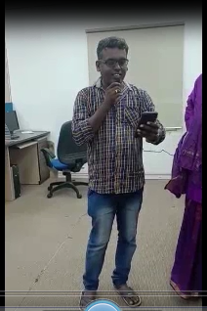














AUG-2022 – Wednesday’s
KONJAM JALLIYA

Slide 15








